Slide 1
Business Model Canvas

Slide 2
Business model canvas is a visual template that helps entrepreneurs document an existing business model or develop a new one. Alexander Osterwalder created it in 2005, based on his academic work on business model ontology.
The business model canvas was designed with startups in mind. It quickly became an alternative to the traditional business plan which wasn’t agile enough to accommodate newly emerging companies.
The revolutionary thing about the business model canvas was that it allowed entrepreneurs to capture a business model on a single page. This made business planning simpler and more structured.

Slide 3
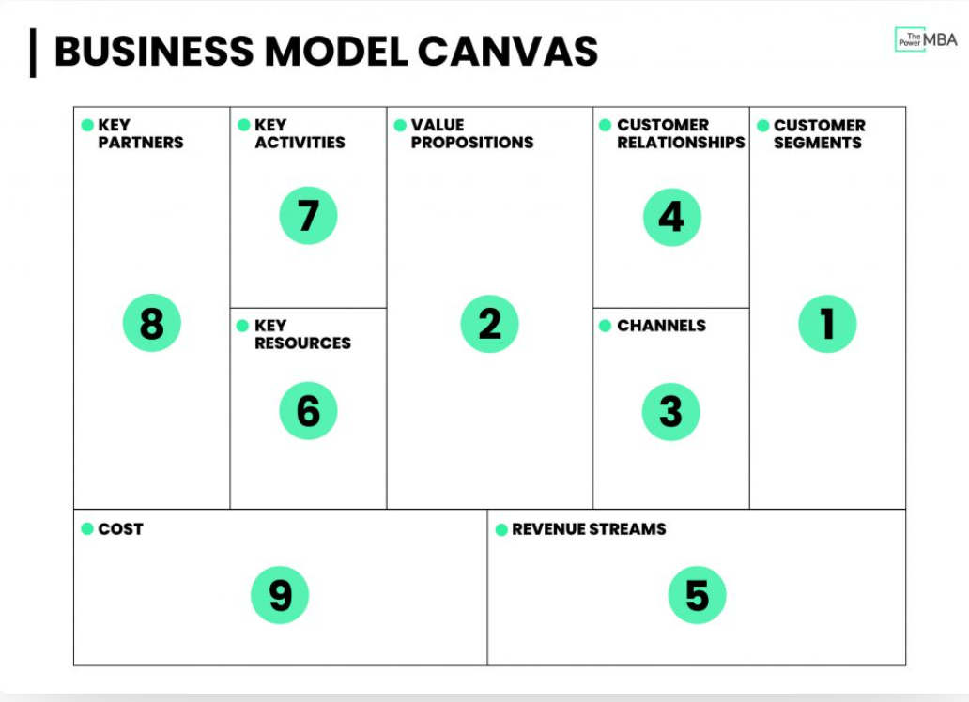
Notes:
The business model canvas allows us to carry out a high-level analysis without drilling down and getting lost in the details.

Slide 4
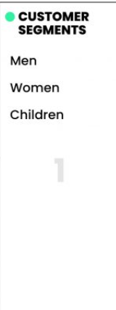
Fashion retail giant Zara
The first block of the Business Canvas Model is about understanding who is the most important customer(s) you’re delivering value to. Or, in other words, who are they? What do they do? And why would they buy your product or service?
Buyer personas are fictional depictions of an ideal or hypothetical client. Typically when brainstorming a buyer persona you’d want to define certain characteristics (age, demographic, gender, income, industry, pain points, goals, etc.)

Slide 5
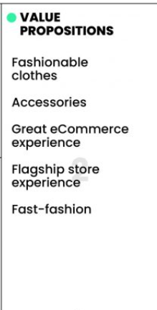
The second phase is about figuring out your company’s value propositions, and importantly, your UVP (unique value proposition). The “what” that makes customers turn to you, over your competitors? Which of their problems are you best at solving?
Zara’s principal value propositions are fairly clear. They offer various ranges of stylish men’s, women’s, and children’s clothing and accessories at an affordable price.
Notes:
Zara demonstrates its aesthetic evolution to customers through its flagship stores. The recent opening of their Hudson Yards, New York City flagship is a great example of this.

Slide 6
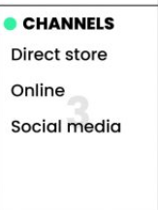
The next step is to ask yourself how you are reaching your customers, and through which channels?
This includes both the channels that customers want to communicate with you as well as how they’ll receive your products or services.
Is it going to be a physical channel? (store, field sales representatives, etc.) Or is it a digital channel? (mobile, web, cloud, etc.).

Slide 7
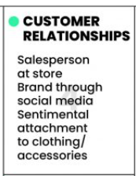
Once you have acquired customers, you will need to think about how you can build, nurture, and grow those relationships.
Zara’s relationship with its customers is threefold, and lies somewhere in the middle of transactional and personal:
Salesperson at store
Brand through social media
Sentimental attachment to a product

Slide 8
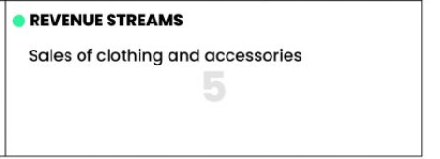
Now that you’ve described how you are going to create real value for your customers, it’s time to look at how you plan to capture that value.
At Zara, it’s extremely simple. They make their money by selling clothes and accessories either at a store or online.

Slide 9
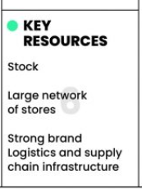
Now it’s time to move over to the left side of the business canvas model and look at what we need, internally, to deliver our value propositions.
The key resources are all things you need to have, or the assets required to create that value for customers.
This could be anything from intellectual property (patents, trademarks, copyrights, etc.) to physical holdings (factories, offices, delivery vans, etc.) right down to finances (the initial cash flow perhaps needed to start your brand)

Slide 10
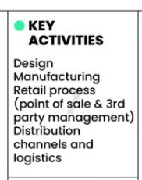
The next step is to define the key activities – the areas you need to be good at to create value for your customers.

Slide 11
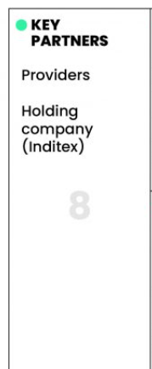
Most modern business models now require brands to build out and work with various key partners to fully leverage their business model.
This includes partnerships such as joint ventures and non-equity strategic alliances as well as typical relationships with buyers, suppliers, and producers.
Zara requires strategic partnerships with many different providers if they are to design and produce their collections.
Another key partner is their major holding company, Inditex.

Slide 12
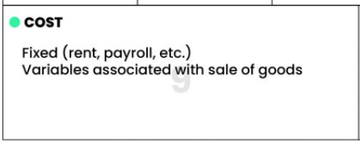
The final step of the Business Model Canvas is to ask yourself, how much is it going to cost to run this model?
This includes some of the more obvious needs such as manufacturing costs, physical space, rent, payroll, but also areas such as marketing activities.

Slide 13
